Slide 1
BSYSC - TEMPLATE

Slide 2
Baytown Saints Youth Soccer Club
www.BaytownSaints.org – FB: @BaytownSaintsSoccer – BTSoccerPresident@Gmail.com

Slide 3
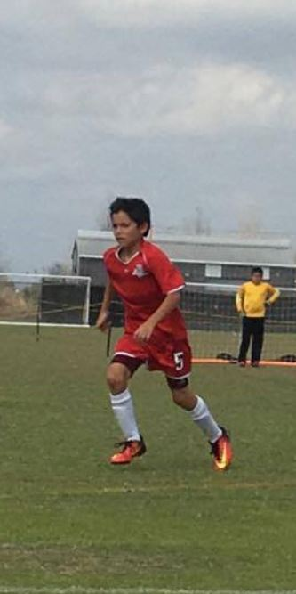
Baytown Saints Youth Soccer Club
TEXT HERE
BAYTOWN
SOCCER
COMPLEX
www.BaytownSaints.org – FB: @BaytownSaintsSoccer – BTSoccerPresident@Gmail.com

Slide 4
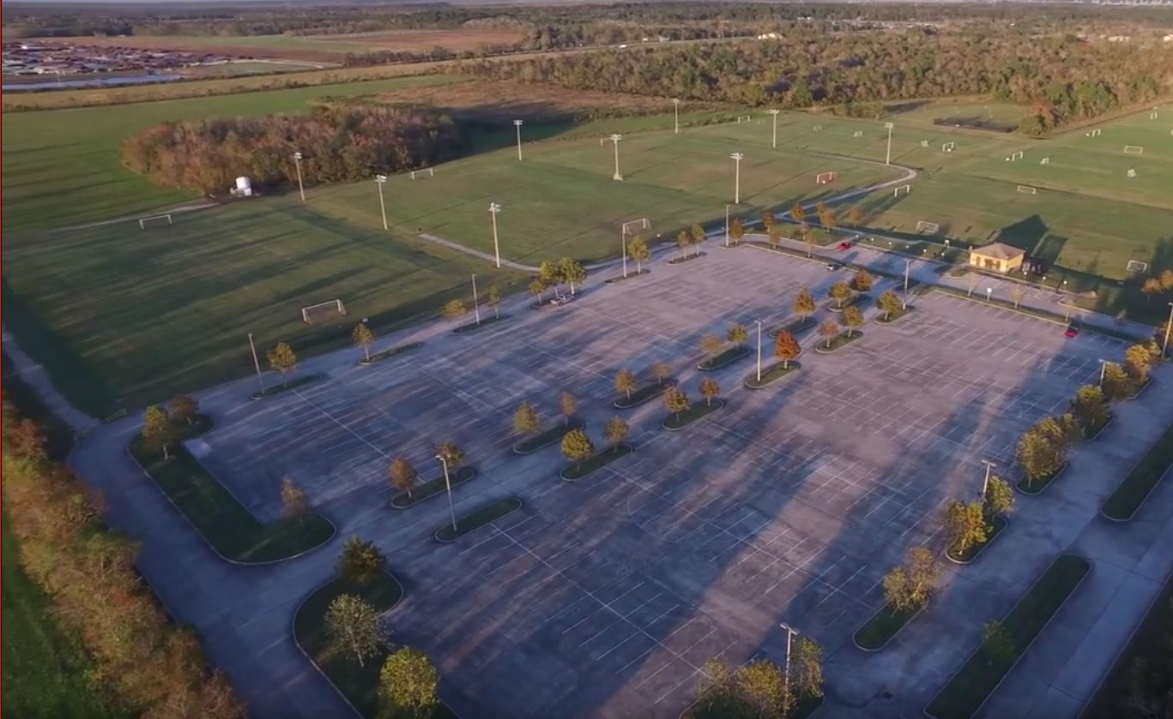
BAYTOWN SAINTS Youth Soccer Club 9600 N. MAIN STREET BAYTOWN, TX
TEXT HERE
BAYTOWN
SOCCER
COMPLEX
www.BaytownSaints.org – FB: @BaytownSaintsSoccer
www.BaytownSaints.org – FB: @BaytownSaintsSoccer – BTSoccerPresident@Gmail.com

Slide 6
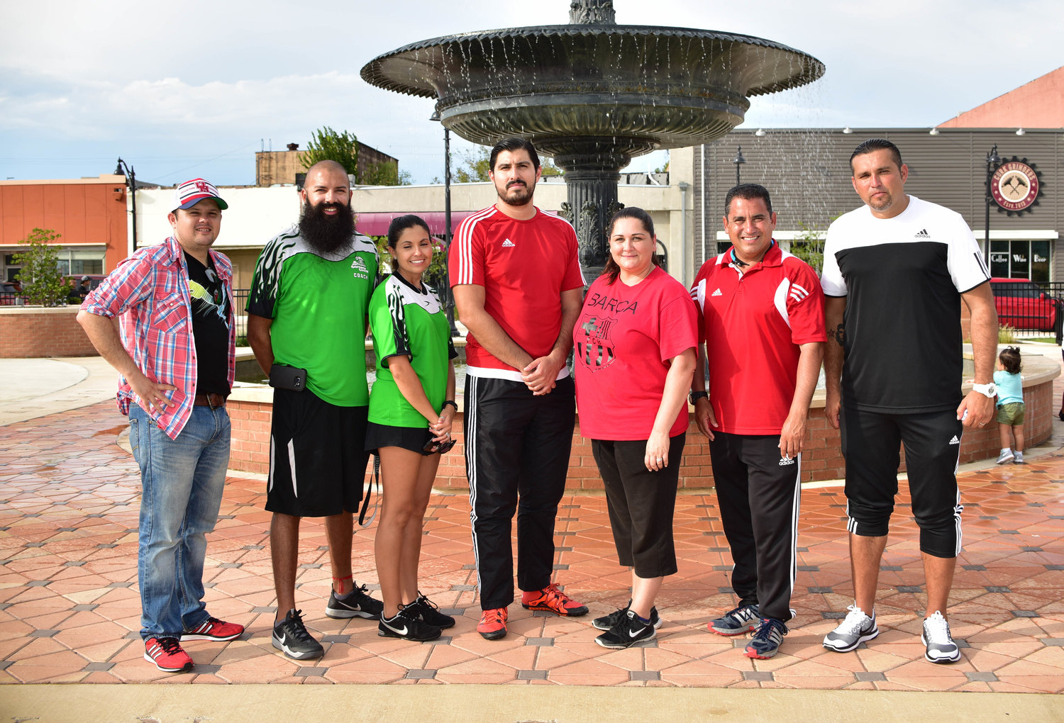
THANK YOU
FOR BECOMING A
BSYSC COACH
BAYTOWN
SOCCER
COMPLEX
www.BaytownSaints.org – FB: @BaytownSaintsSoccer
www.BaytownSaints.org – FB: @BaytownSaintsSoccer – BTSoccerPresident@Gmail.com

Slide 7
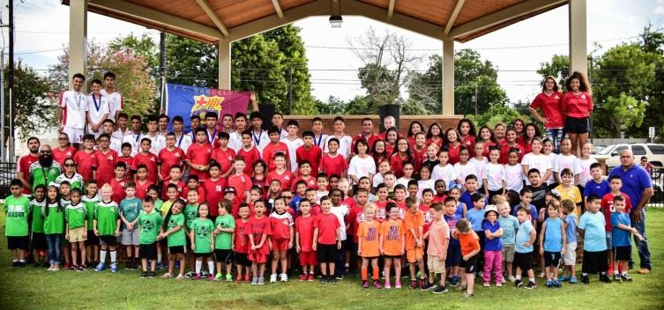
THANK YOU
FOR
DONATING!
BAYTOWN
SOCCER
COMPLEX
www.BaytownSaints.org – FB: @BaytownSaintsSoccer
www.BaytownSaints.org – FB: @BaytownSaintsSoccer – BTSoccerPresident@Gmail.com

Slide 8
PLEASE REMEMBER
1. THESE ARE KIDS
2. THIS IS A GAME
3. THE COACHES ARE VOLUNTEERS
4. THE REFEREES ARE HUMAN
5. THIS IS NOT THE WORLD CUP
BAYTOWN
SOCCER
COMPLEX
www.BaytownSaints.org – FB: @BaytownSaintsSoccer
www.BaytownSaints.org – FB: @BaytownSaintsSoccer – BTSoccerPresident@Gmail.com

Slide 9
PLEASE REMEMBER
1. THESE ARE KIDS
2. THIS IS A GAME
3. THE COACHES ARE VOLUNTEERS
4. THE REFEREES ARE HUMAN
5. THIS IS NOT THE WORLD CUP
BAYTOWN
SOCCER
COMPLEX
www.BaytownSaints.org – FB: @BaytownSaintsSoccer
www.BaytownSaints.org – FB: @BaytownSaintsSoccer – BTSoccerPresident@Gmail.com

Slide 10
Thank you!
BSYSC WHISHES YOU A SAFE AND SUCCESSFUL SEASON!

